Slide 1
Capstone Project - The Battle of Neighborhoods
Selecting the best location to open a Japanese Restaurant in Brooklyn, New York

Slide 2
Introduction/Business Problem
The City of New York is famous for its excelllent cuisine. It's food culture includes an array of international cuisines influenced by the city's immigrant history.
Japanese restaurants have become so popular in the United States now it seems that there is one on every corner, not only in major cities but also in smaller cities. Starting a Japanese restaurant can be a great business opportunity, but you need to distinguish yourself from others to enjoy long-term success.

Slide 3
Business Problem
My client wants to open his business in Brooklyn area, so I focus on that borough during my analysis. We define potential neighborhood based on the number of sushi bars which are operating right in each neighborhood. Brooklyn has full potential but also is a very challenging district to open a business because of high competition. New Japanese restaurant should be open in an area that inadequate neighborhood in this way the bar can attract more customers. Therefore, this analysis necessary to ensure that we have enough customers and that we are not so close to other places.

Slide 4
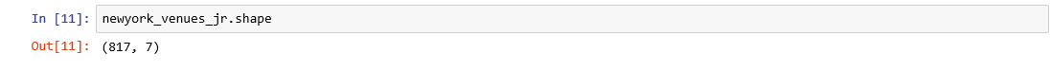
Data Selection
To identify the characteristics of our competitors' venues in Brooklyn, we would first need to find out the number of Japanese restaurants in the borough currently and their location.
We then used Google Map API to find their geographic coordinates based on their postal code addresses.
In Brooklyn, 817 Japanese restaurants are currently operating.

Slide 5
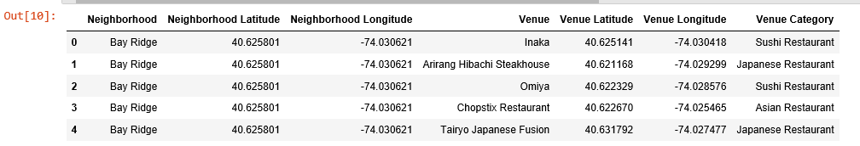
Data Selection
Next, we also used Google Map API to find their geographic coordinates of the 5 locations shortlisted for our sushi bar:
Table 2: Data frame containing geographic coordinates of our 5 shortlisted locations

Slide 6
Methodology
Addresses are converted into their equivalent latitude and longitude values.
Foursquare API is used to explore neighborhoods in Brooklyn, New York.
After that, explore function to get Japanese restaurant categories in each neighborhood.

Slide 7
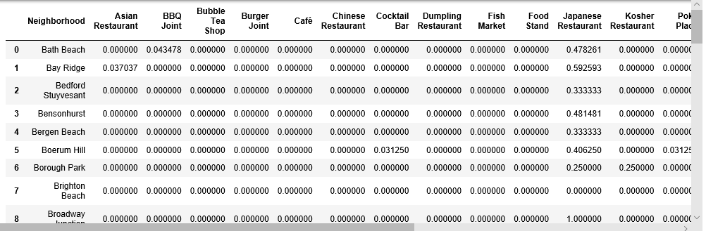
Methodology

Slide 8
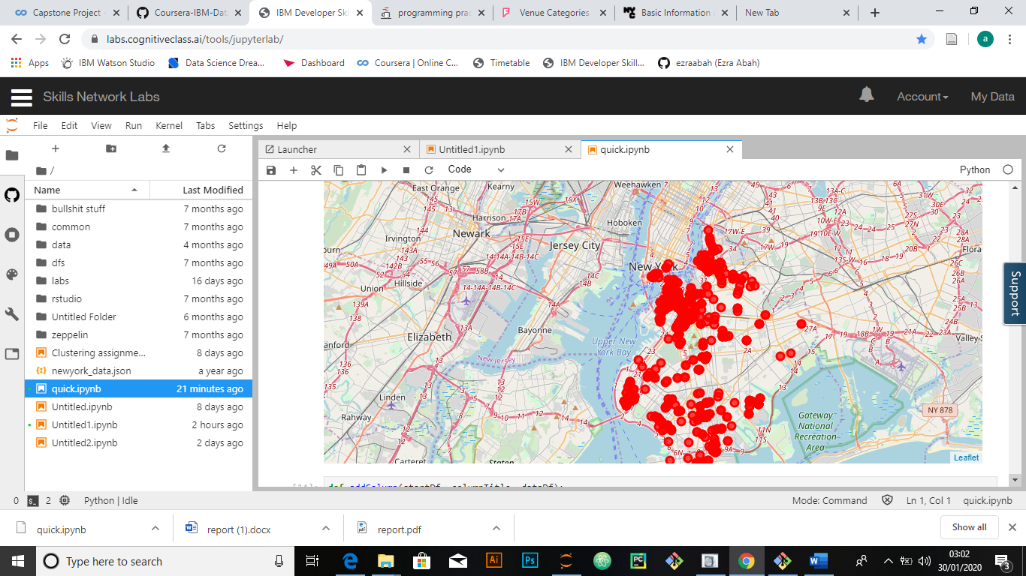
Methodology
Japanese
Restaurants in
Brooklyn

Slide 9
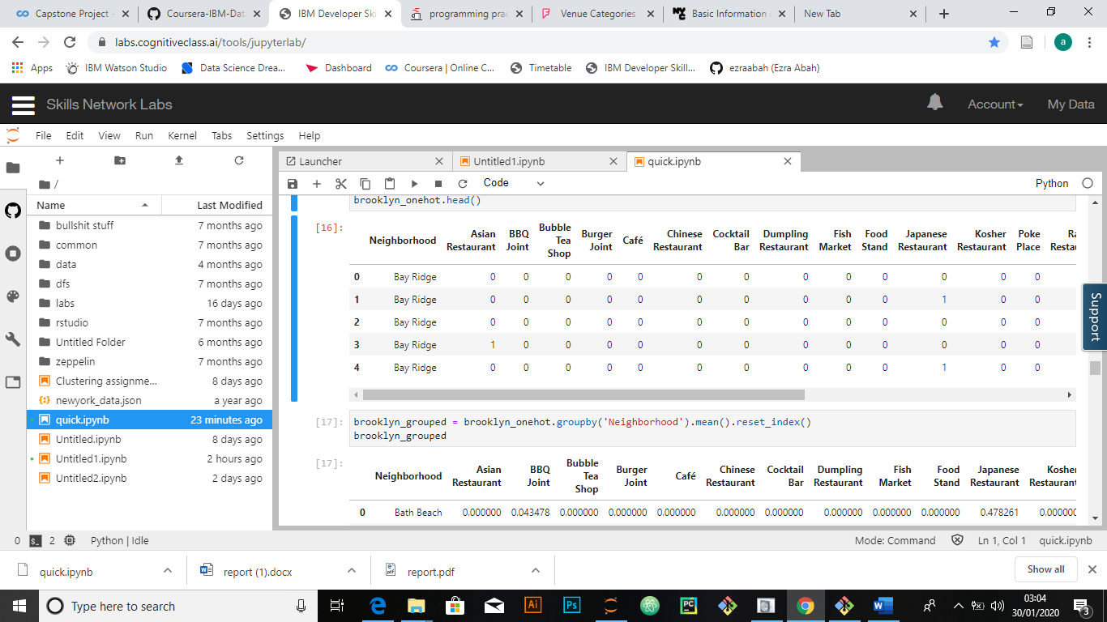
Methodology
Then using this feature to group the neighborhoods into clusters K-means clustering algorithm will be use to complete this task. And also, the Folium library to visualize the neighborhoods in Manhattan and its emerging clusters.

Slide 10
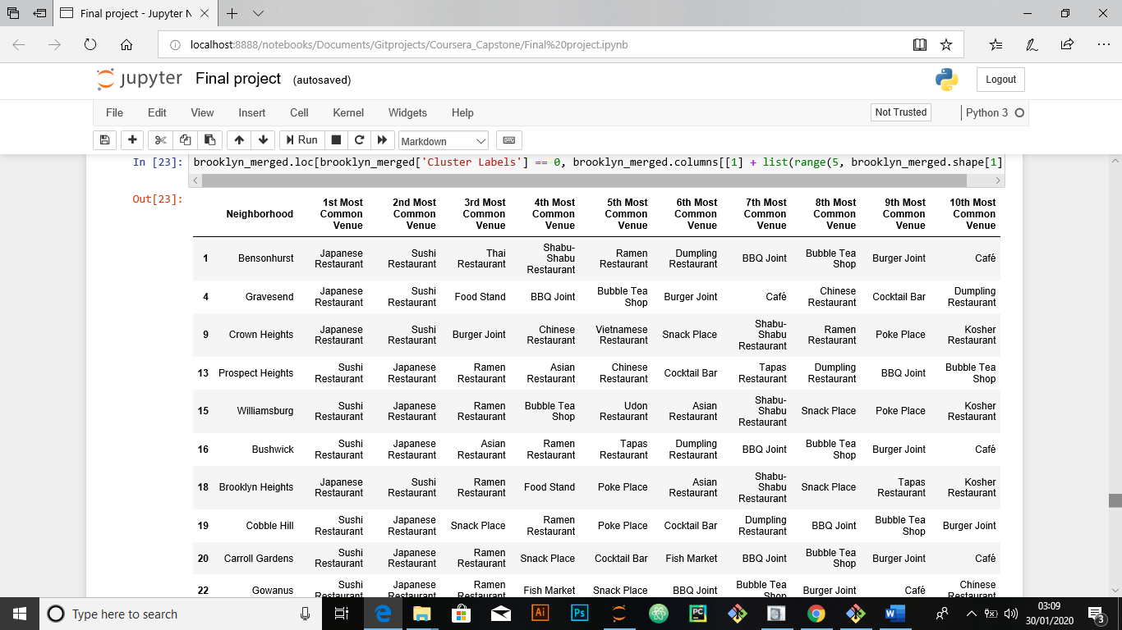
Results
Using K-mean to clustering data area with less number of sushi bars
Cluster 0

Slide 11
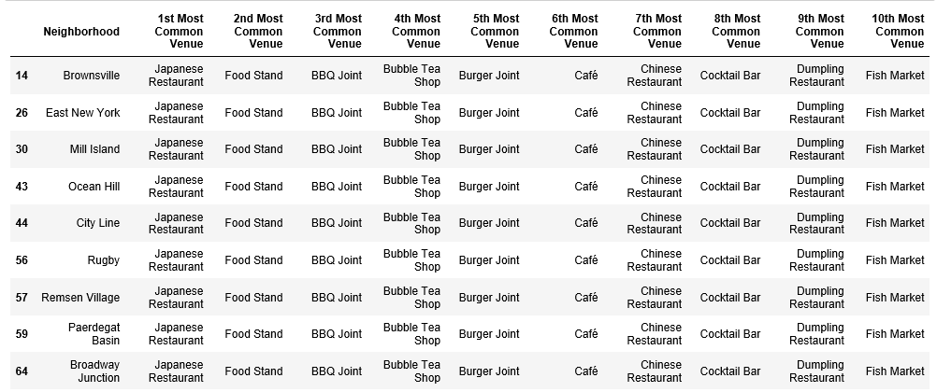
Result
Cluster 1

Slide 12
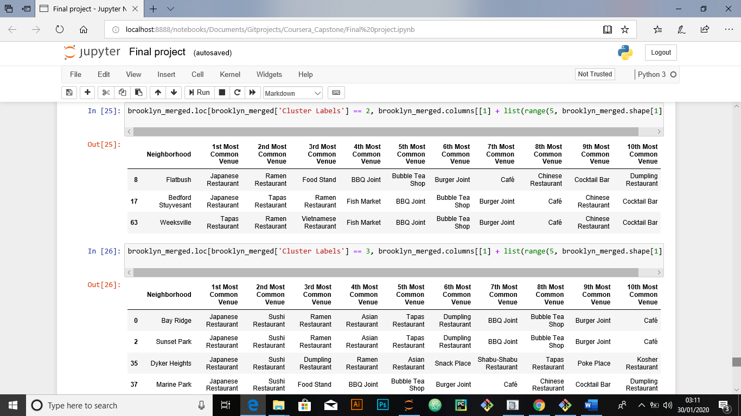
Result
Cluster 2

Slide 13
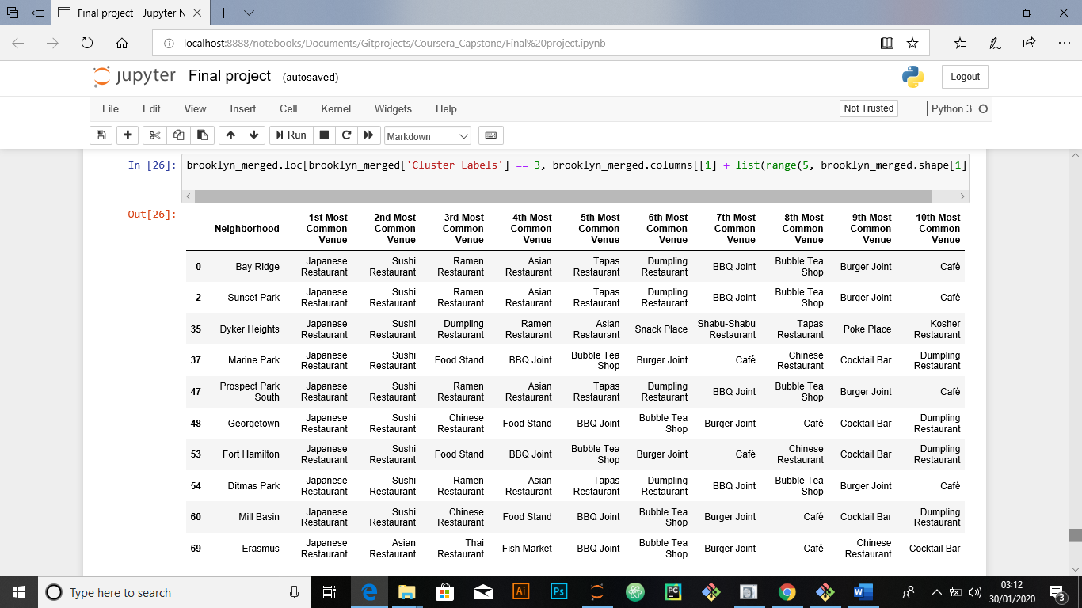
Result
Cluster 3

Slide 14
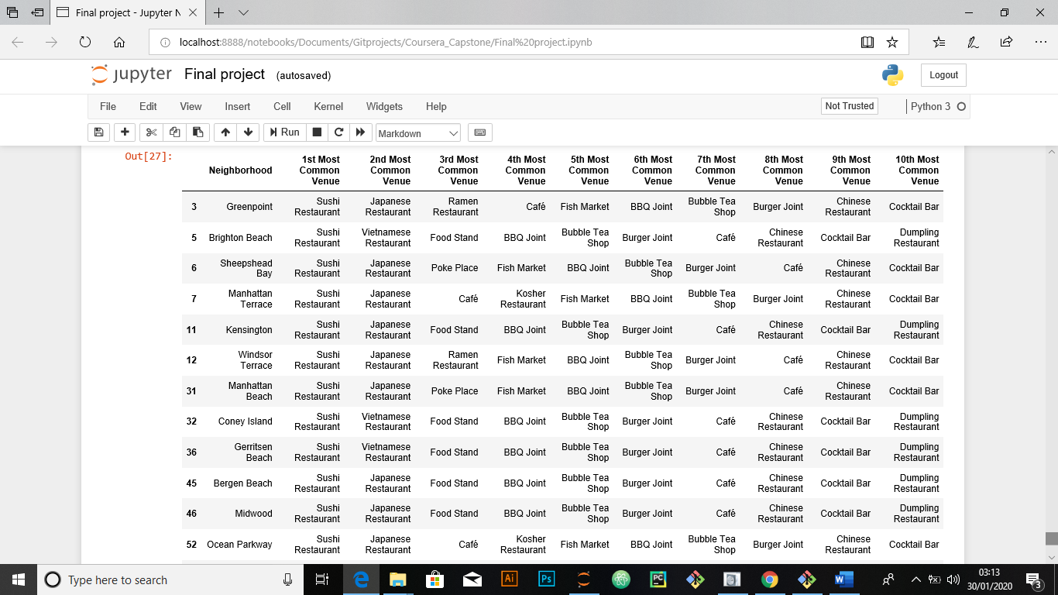
Result
Cluster 4

Slide 15
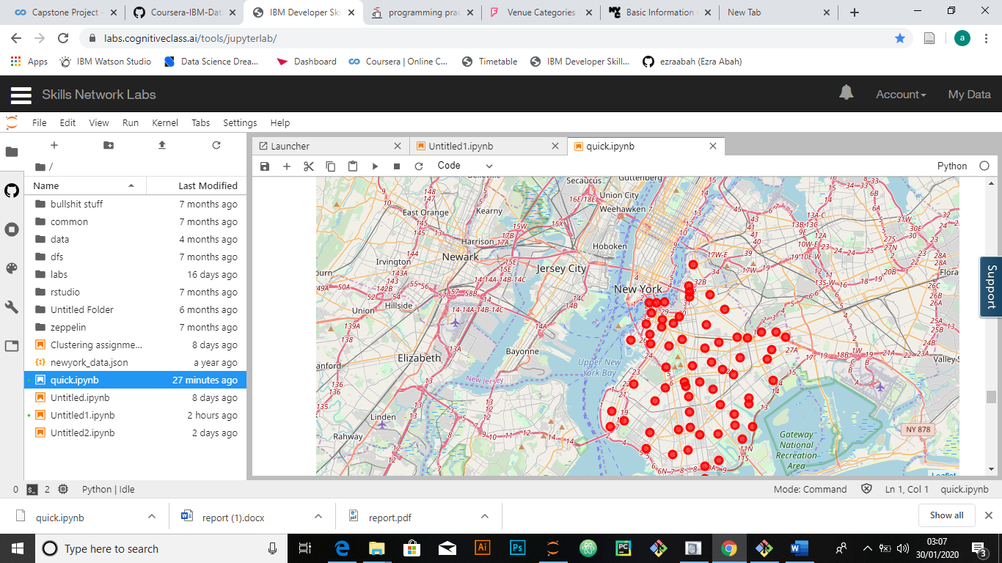
Result

Slide 16
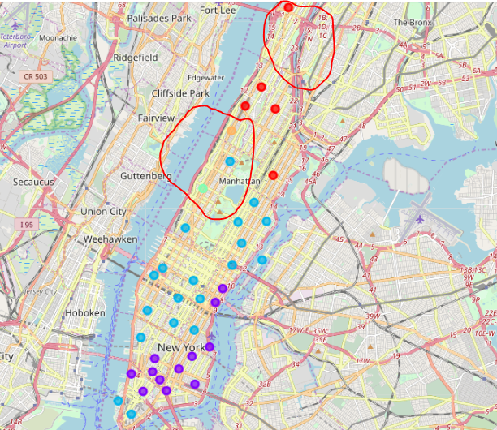
Result
Based on dataframe analysis above Cluster 3 (Upper West Side ) and Cluster 4 (Morningside Heights) areas are the best places to open a new sushi bar business.

Slide 17
Discussion
This analysis is performed on limited data. This may be right or may be wrong. But if good amount of data is available there is scope to come up with better results.
There is high competition in Midtown and Soho so it is very risky to open business in these areas.
Central Harlem has also potential where closes to Morningside Heights area.
It can be done more detailed analysis by adding other factors such as transportation, demographics of inhabitants.

Slide 18
Conclusion
Although all of the goals of this project were met there is definitely room for further improvement and development as noted below. However, the goals of the project were met and, with some more work, could easily be devleoped into a fully phledged application that could support the opening a business idea in an unknown location.

